Slide 1

Introduction
Semİh Ay
One day your life will flash before your eyes.
Make sure it's worth watching.

Slide 2


CV
09.2023 – Currently
Data Science and
Artificial Intelligence
M. Sc.
Boğaziçi University– İstanbul
High School Years (Olympiad)
Thesis Topic
Research Interests
09.2018 - 06.2023
Mathematics B. Sc.
(Honour Degree 3.04/4.00)
Boğaziçi University– İstanbul
09.2014 - 06.2018
High School (96.68/100)
Nilüfer Borsa İstanbul Science
High School– Bursa

Slide 3

LinkedIn
https://www.linkedin.com/in/semih-ay-258585266/

Slide 4
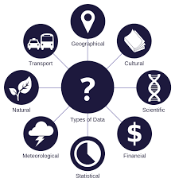
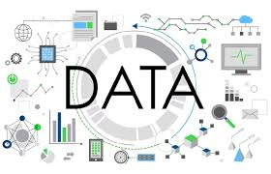
Data
Notes:
Data (/ˈdeɪtə/ DAY-tə, US also /ˈdætə/ DAT-ə) are a collection of discrete or continuous values that convey information, describing the quantity, quality, fact, statistics, other basic units of meaning, or simply sequences of symbols that may be further interpreted formally.

Slide 5
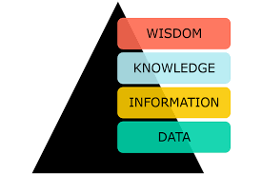
Data

Slide 6
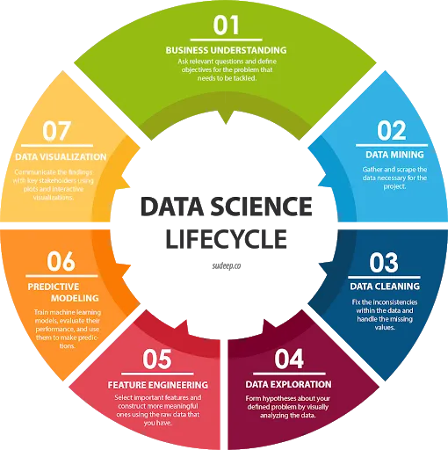
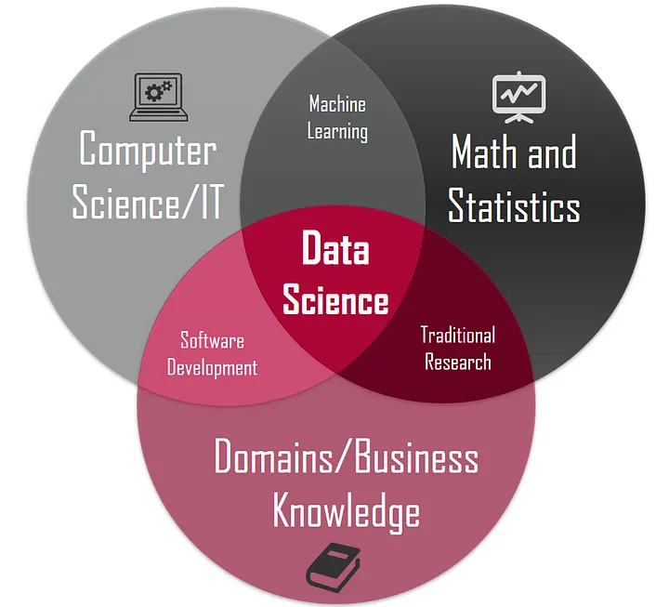
Data Science

Slide 7
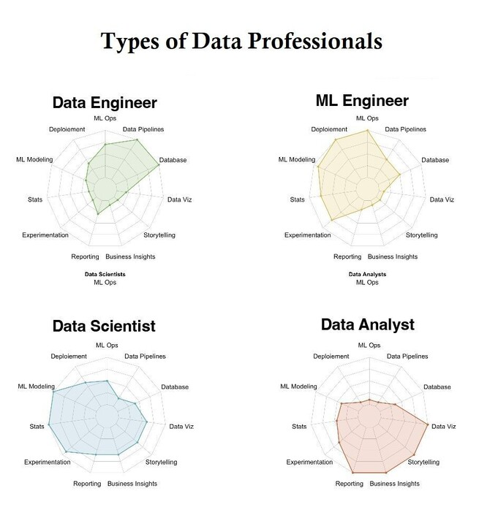

Slide 8
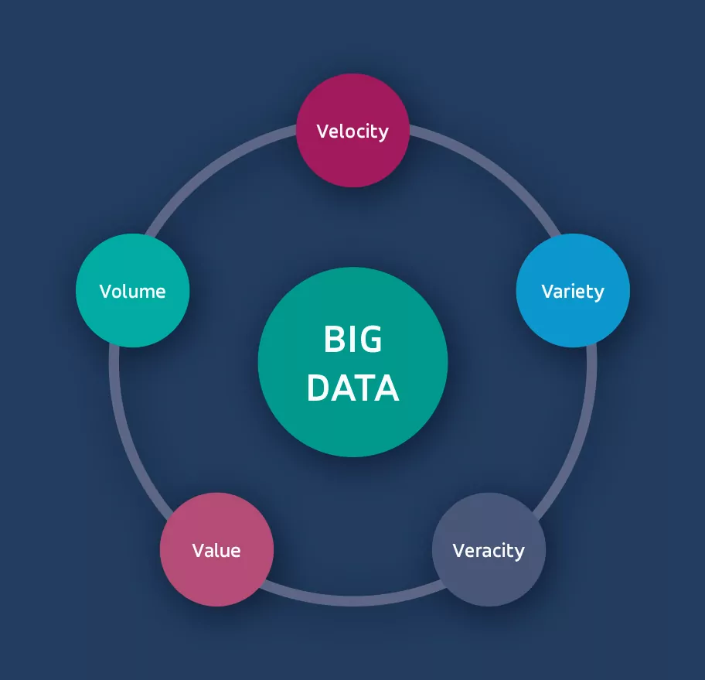
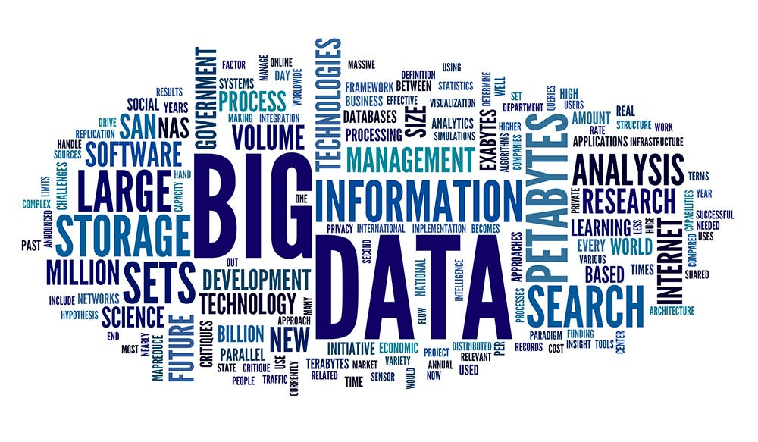
Big Data

Slide 9

Python vs. R

Slide 10

Where to Work on?

Slide 11
Future Works
What can we do?
What can you do?

